Slide 1
CSM 491 - Graph Theory and Its Application
Lectures
by
Dr. Oliver Kornyo
Dept. of Computer Science

Slide 2
COLORING, COVERING, AND PARTITIONING
Lecture Outline
Chromatic Number
Chromatic Partitioning
Dominating Set
Chromatic Polynomial
Coverings

Slide 3
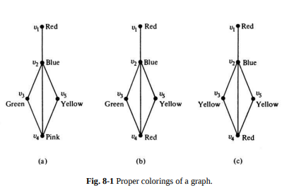
CHROMATIC NUMBER
Painting all the vertices of a graph with colours such that no two adjacent vertices have the same colour is called the proper colouring (or sometimes simply colouring) of a graph.
A graph in which every vertex has been assigned a colour according to a proper colouring is called a properly coloured graph.
Figure 8-1 shows three different proper colourings of a graph

Slide 4
For coloring problems we need to consider only simple, connected graphs. Some observations that follow directly are
1. A graph consisting of only isolated vertices is 1-chromatic.
2. A graph with one or more edges (not a self-loop, of course) is at least 2- chromatic (also called bichromatic).
3. A complete graph of n vertices is n-chromatic, as all its vertices are adjacent. Hence a graph containing a complete graph of r vertices is at least r-chromatic. For instance, every graph having a triangle is at least 3- chromatic.
4. A graph consisting of simply one circuit with n ≥ 3 vertices is 2-chromatic if n is even and 3-chromatic if n is odd. (This can be seen by numbering vertices 1, 2, . . ., n in sequence and assigning one colour to odd vertices and another to even

Slide 5
CHROMATIC PARTITIONING
A proper coloring of a graph naturally induces a partitioning of the vertices into different subsets. For example, the coloring in Fig. 8-1(c) produces the partitioning {v1 , v4}, {v2}, and {v3 , v5}.
A set of vertices in a graph is said to be an independent set of vertices or simply an independent set (or an internally stable set) if no two vertices in the set are adjacent. For example;’ in Fig. 8-3, {a, c, d} is an independent set. A single vertex in any graph constitutes an independent set.

Slide 6
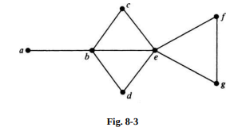
Maximal independent set
A maximal independent set (or maximal internally stable set) is an independent set to which no other vertex can be added without destroying its independence property. The set {a, c, d, f} in Fig. 8-3 is a maximal independent set.
The set {b, f} is another maximal independent set. The set {b, g} is a third one.

Slide 7
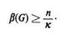
Coefficient of internal stability
The number of vertices in the largest independent set of a graph G is called the independence number (or coefficient of internal stability), β{G).
Consider a κ-chromatic graph G of n vertices properly colored with κ different colors. Since the largest number of vertices in G with the same color cannot exceed the independence number β(G), we have the inequality

Slide 8
Finding a Maximal Independent Set
A reasonable method of finding a maximal independent set in a graph G will be to start with any vertex v of G in the set. Add more vertices to the set, selecting at each stage a vertex that is not adjacent to any of those already selected.
This procedure will ultimately produce a maximal independent set. This set, however, is not necessarily a maximal independent set with.a largest number of vertices.

Slide 9
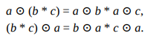
Finding All Maximal Independent Sets
A reasonable (but not very efficient for large graphs) method for obtaining all maximal independent sets in any graph can be developed using Boolean arithmetic on the vertices. Let each vertex in the graph be treated as a Boolean variable.
Let the logical (or Boolean) sum a + b denote the operation of including vertex a or b or both; let the logical multiplication ab denote the operation of including both vertices a and 6, and let the Boolean complement a′ denote that vertex a is not included.

Slide 10
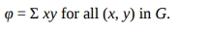
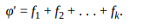
For a given graph G we must find a maximal subset of vertices that does not include the two end vertices of any edge in G. Let us express an edge (x, y) as a Boolean product, xy, of its end vertices x and y, and let us sum all such products in G to get a Boolean expression
Let us further take the Boolean complement φ′ of this expression, and express it as a sum of Boolean products :

Slide 11
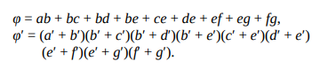
A vertex set is a maximal independent set if and only if φ = 0 (logically false), which is possible if and only if φ′ = 1 (true), which is possible if and only if at least one f i . = 1, which is possible if and only if each vertex appearing in f1 , (in complemented form) is excluded from the vertex set of G. Thus each f i will yield a maximal independent set, and every maximal independent set will be produced by this method.

Slide 12
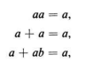
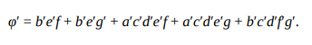
Multiplying these out and employing the usual identities of Boolean arithmetic, such as
we get

Slide 13
Finding Independence and Chromatic Numbers:
Once all the maximal independent sets of G have been obtained, we find the size of the one with the largest number of vertices to get the independence number β(G). The independence number of the graph in Fig. 8-3 is four.
To find the chromatic number of G, we must find the minimum number of these (maximal independent) sets, which collectively include all the vertices of G. For the graph in Fig. 8-3, sets {a, c, d, f}, {b,g}, and {a, e}, for example, satisfy this condition. Thus the graph is 3-chromatic.

Slide 14
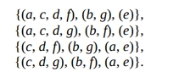
Chromatic Partitioning
Given a simple, connected graph G, partition all vertices of G into the smallest possible number of disjoint, independent sets. This problem, known as the chromatic partitioning of graphs, is perhaps the most important problem in partitioning of graphs.
The following four are some chromatic partitions of the graph in Fig. 8-3, for example.

Slide 15
Dominating Sets
A dominating set (or an externally stable set) in a graph G is a set of vertices that dominates every vertex v in G in the following sense: Either v is included in the dominating set or is adjacent to one or more vertices included in the dominating set. For instance, the vertex set {b, g} is a dominating set in Fig. 8-3. So is the set {b, g, b, g, f} a dominating set. A dominating set need not be independent. For example, the set of all its vertices is trivially a dominating set in every graph.

Slide 16
Minimal dominating set
A minimal dominating set is a dominating set from which no vertex can be removed without destroying its dominance property. For example, in Fig. 8-3, {b, e} is a minimal dominating set. And so is {a, c, d, f}. Observations that follow from these definitions are
1. Any one vertex in a complete graph constitutes a minimal dominating set.
2. Every dominating set contains at least one minimal dominating set.
3. A graph may have many minimal dominating sets, and of different sizes. [The number of vertices in the smallest minimal dominating set of a graph G is called the domination number, α(G).]
4. A minimal dominating set may or may not be independent.

Slide 17
CHROMATIC POLYNOMIAL
In general, a given graph G of n vertices can be properly colored in many different ways using a sufficiently large number of colors.
This property of a graph is expressed elegantly by means of a polynomial. This polynomial is called the chromatic polynomial of G and is defined as follows :
The value of the chromatic polynomial Pn (λ) of a graph with n vertices gives the number of ways of properly coloring the graph, using λ or fewer colors

Slide 18
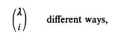
Let ci be the different ways of properly coloring G using exactly i different colors. Since i colors can be chosen out of λ colors in
there are different ways of properly coloring G using exactly i colors out of λ colors. Since i can be any positive integer from 1 to n (it is not possible to use more than n colors on n vertices), the chromatic polynomial is a sum of these terms; that is,

Slide 19
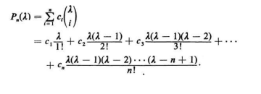
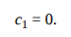
Each ci has to be evaluated individually for the given graph. For example, any graph with even one edge requires at least two colors for proper coloring, and therefore
A graph with n vertices and using n different colors can be properly colored in n! ways; that is,

Slide 20
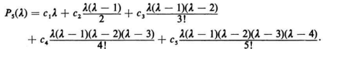
As an illustration, let us find the chromatic polynomial of the graph given in Fig. 8-4.

Slide 21
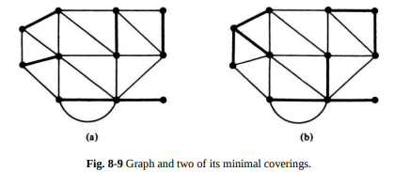
COVERINGS
In a graph G, a set g of edges is said to cover G if every vertex in G is incident on at least one edge in g. A set of edges that covers a graph G is said to be an edge covering, a covering subgraph, or simply a covering of G. For example, a graph G is trivially its own covering. A spanning tree in a connected graph (or a spanning forest in an unconnected graph) is another covering.
In Fig. 8-9 a graph and two of its minimal coverings are shown in heavy lines.

Slide 22
Assignment 7
In a chessboard, show the positions of
(a) The minimum number of queens that collectively dominate all 64 squares (an example of a minimal dominating with smallest number of vertices).
(b) The maximum number of queens such that none of them can take another (an example of a maximal independent set with largest number of vertices)

Slide 23
THANK YOU

